Slide 1
Progress Report: Kisaan Bandhu
Meet Bhanushali 1711005
Govinda Patel 1711038
Parth Sheth 1711055
Shailesh Upadhyay 1711061

Slide 2
Overview
Expected delivery
May, 2021
Recent progress
Problem Definition
Scope
Literature Survey
B.Tech Final Report
SRS Document
Methodology
Future Scope
References

Slide 3
1 - Problem Definition
Kisaan Bandhu is an application to empower the farmers by helping them reach the buyer through our application. The application will have a major role of connecting the end users via the application which will basically work as connector application for buying and selling the products which the farmers will directly put over the application for sale.Also we will implement a contract based feature wherein the farmers and the client company can have a production contract between themselves for which this application will be a mediator.

Slide 4
Motivation
Kisaan Bandhu will enable the farmer to directly reach the buyers such as bulk buyers and supermarkets hence cutting out the extra cost due the increase in the cycle due to the profit margins of the Dealers. Also the entire profit made by selling the product is received by the farmer. This application will be mainly used by farmers after crop season who need immediate sell of crops and transport to storages this system will also enable the buyers to directly place some bids on all agricultural products. Contract based deals which will be managed by our application.

Slide 5
2 - Scope
1. First of all what we will try to achieve is to remove the unnecessary cycle in between the demand supply chain.We will try to create such a system where there will be direct buyers such as supermarts or a bulk buyer where we will directly supply the production from the farmers.Our cycle will try include maximum areas of production as we will also include transport services.
2. The second task which will try to implement is to create a contract based production which will be provided by the companies. In this type what we are trying to achieve is that we will take certain contracts from the companies If the farmer decides to accept the contract then the company will provide the materials required for proper production. The company will also provide the details of the materials they will provide to the farmers for the proper production of the raw material.

Slide 6
3 - Literature Survey
For Literature Survey we have prepared a separate document.
Click here for Literature Survey.
For this document we have referred some Indian Law regarding the farmers and production allowances such as :-
THE FARMERS’ PRODUCE TRADE AND COMMERCE(PROMOTION AND FACILITATION) ORDINANCE, 2020
Role of APMCs in Agricultural Marketing in India- A Study
Farmers Suicides in India research paper
Farmer Suicides in India - Trends across Major States, 1995–2011
THE FARMERS’ PRODUCE TRADE AND COMMERCE (PROMOTION AND FACILITATION) ACT, 2020
THE FARMERS (EMPOWERMENT AND PROTECTION) AGREEMENT ON PRICE ASSURANCE AND FARM SERVICES ACT, 2020
THE AGRICULTURAL PRODUCE (GRADING AND MARKING) ACT, 1937

Slide 7
4 - SRS
For SRS Document we have prepared a separate document.
Click here for SRS Document.

Slide 8
5 – B.Tech Final Report
For Final Report we have prepared a separate document.
Click here for Final Year Project Document.

Slide 9
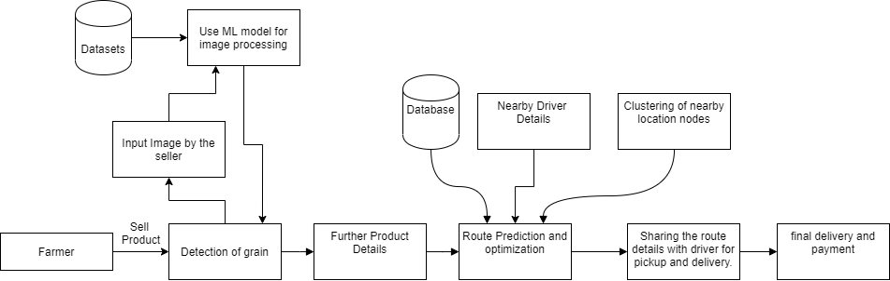
Diagrams
For different diagrams please click on the following link.
Click here for diagrams.
Architectural Diagram

Slide 10
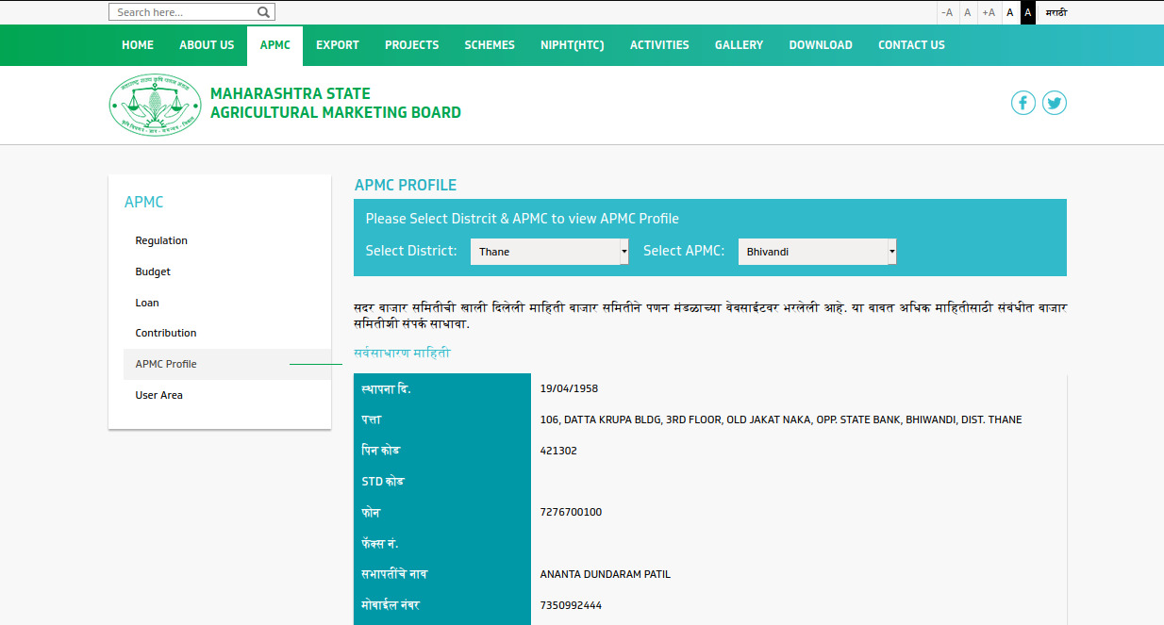
6 – Algorithms and Techniques used
WebScraping
Web scraping is data scraping used for extracting data from websites. Web scraping software may access the World Wide Web directly using the Hypertext Transfer Protocol, or through a web browser. While web scraping can be done manually by a software user, the term typically refers to automated processes implemented using a bot or web crawler. It is a form of copying, in which specific data is gathered and copied from the web, typically into a central local database or spreadsheet, for later retrieval or analysis.

Slide 11
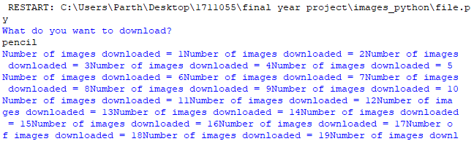
6 – Algorithms and Techniques used
Automation for Downloading Image

Slide 12
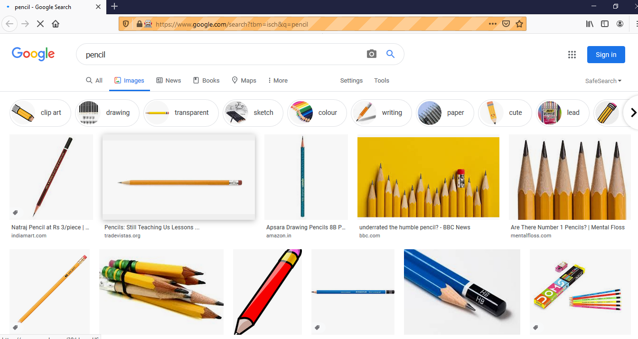
6 – Algorithms and Techniques used
Automation for Downloading Image

Slide 13
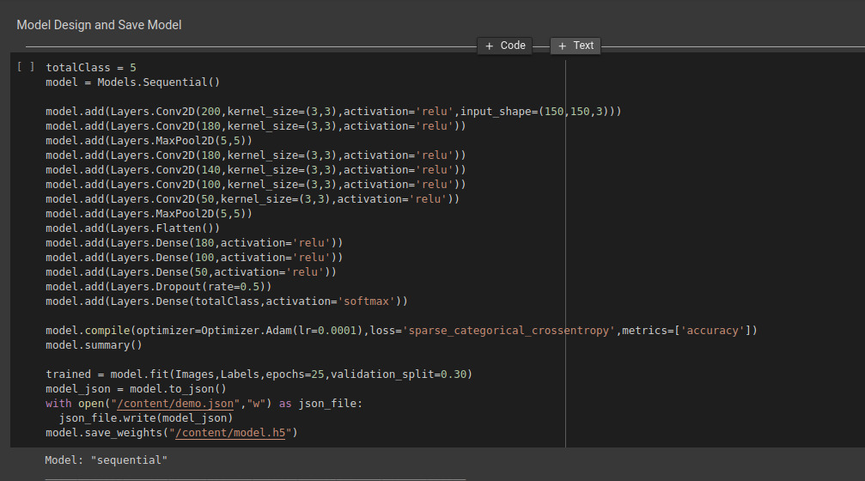
6 – Algorithms and Techniques used
Convolution Neural Network (CNN model)
A Convolutional Neural Network (ConvNet/CNN) is a Deep Learning algorithm which can take in an input image, assign importance (learnable weights and biases) to various aspects/objects in the image and be able to differentiate one from the other. The pre-processing required in a ConvNet is much lower as compared to other classification algorithms. While in primitive methods filters are hand-engineered, with enough training, ConvNets have the ability to learn these filters/characteristics.

Slide 14
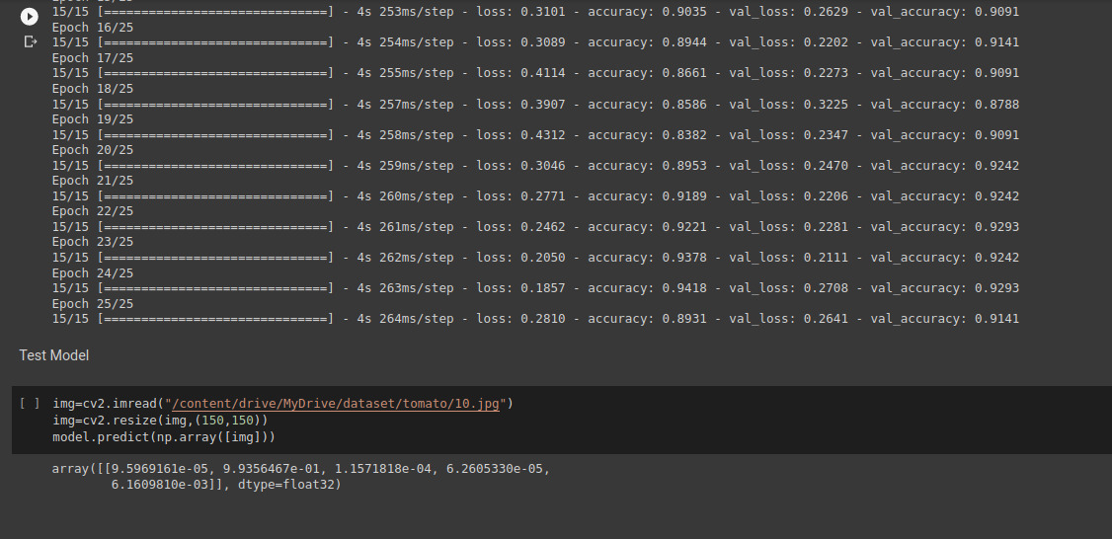
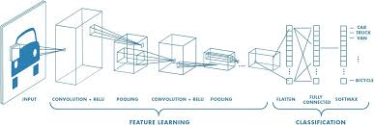
6 – Algorithms and Techniques used
Convolution Neural Network (CNN model)

Slide 15
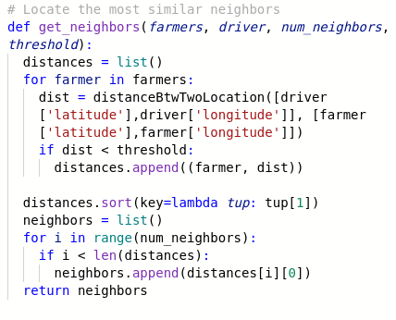
6 – Algorithms and Techniques used
Clustering Analysis
Cluster analysis or clustering is the task of grouping a set of objects in such a way that objects in the same group (called a cluster) are more similar (in some sense) to each other than to those in other groups (clusters). It is a main task of exploratory data mining, and a common technique for statistical data analysis, used in many fields, including pattern recognition, image analysis, information retrieval, bioinformatics, data compression, computer
graphics and machine learning.

Slide 16
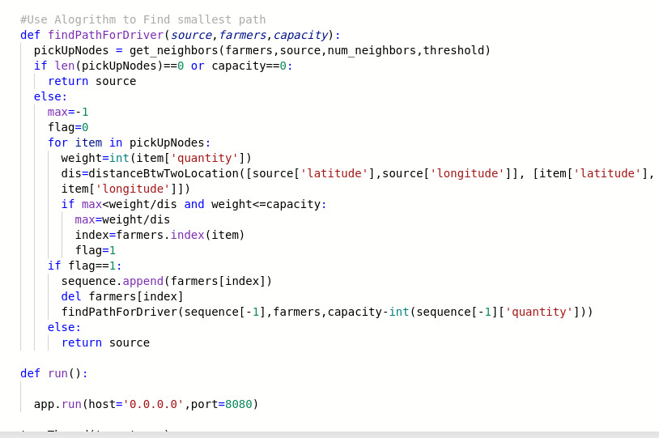
6 – Algorithms and Techniques used
Modified Greedy 0/1 Knapsack
Given a set of items, each with a weight and a value, determine a subset of items to include in a collection so that the total weight is less than or equal to a given limit and the total value is as large as possible.
The knapsack problem is in combinatorial optimization problem. It appears as a subproblem in many, more complex mathematical models of real-world problems. One general approach to difficult problems is to identify the most restrictive constraint, ignore the others, solve a knapsack problem, and somehow adjust the solution to satisfy the ignored constraints.

Slide 17
6 – Algorithms and Techniques used
HTTP Protocol
HTTP functions as a request–response protocol in the client–server computing model. A web browser, for example, may be the client and an application running on a computer hosting a website may be the server. The client submits an HTTP request message to the server. The server, which provides resources such as HTML files and other content, or performs other functions on behalf of the client, returns a response message to the client. The response contains completion status information about the request and may also contain requested content in its message body.

Slide 18
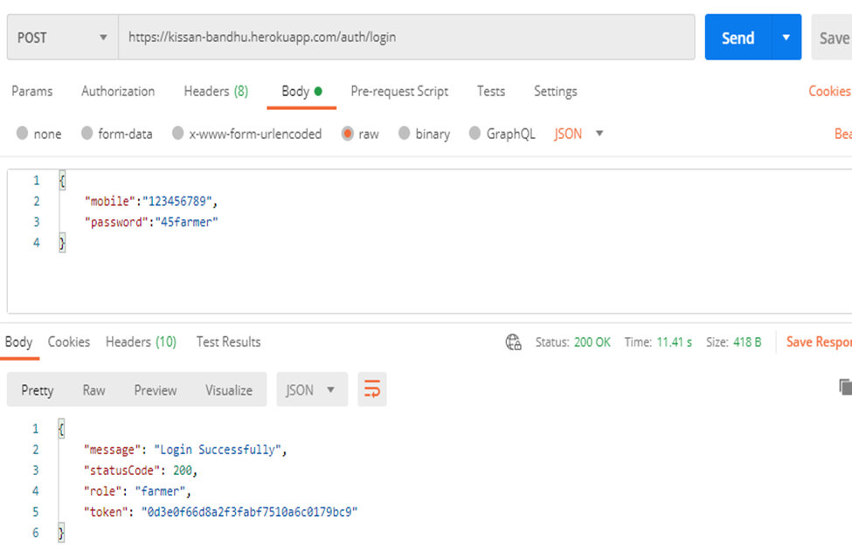
6 – Algorithms and Techniques used
HTTP Protocol

Slide 19
6 – Some of the Tools Used
Flutter
Python
News API
Node.js
MongoDB
MapBox
Firebase
Colab
Heroku

Slide 20
7 - Methodology
Sell and Buy of the product
A. Activity 1 - Farmer posts the product on the application
Authentication of the farmer via the Login into the application.
Posting of the product on the application.
Detecting the food grain by using CNN model.
Filling the details of the product.
Final submission of the product for sale on the application.
Tracking of the application for the product in the sale cycle.
Final status of the product .

Slide 21
7 - Methodology
Sell and Buy of the product
B. Activity 2 - Transportation of the product by the Driver
Checking the availability of Driver for pickup
Assigning list of pickup locations for driver.
Deciding group of pickup location using clustering analysis based on pincode
Using Modified Travelling Salesman Problem to predict the optimised route for pickup and distribution.

Slide 22
7 - Methodology
Sell and Buy of the product
C. Activity 3 - Buying the product
Buyer places the bid for the product on the application
Using greedy approach for allotment amount of product
Accepting the payment for the product using the payment gateway.

Slide 23
7 - Methodology
2. Contract based sales
A. Activity 1 - Client
Details for the product to be grown
Quantity of the required product to be grown
Notifying farmers for the availability of a contract
B. Activity 2 - Assigning of the contract to the farmers by conditional mapping

Slide 24

8 – Completed Implementation
Geolocator – Getting the latitude and longitude of the current user.
Camera Access – Getting image of the grain for classification
DB Deployment – Multiple user by having live database.
Deployment of some API’s on Heroku
Parts of Frontend UI - Some of the UI modules of farmer is completed.
Web Scrapping – Finding images for dataset to feed into CNN model.

Slide 25
Implementation Screenshots
The following Drive folder has some of the implementation screenshots
screenshots

Slide 26
9- Future Scope
Creating a network and chain of the farmers to make efficient production cycle.
Creating a network of producers and consumers while maintaining supply chain among them.
Better transparency of transaction using Blockchain technology.
Predicting the future demand of a particular product in and hence making shift in storage of the product by utilizing the empty rounds making the transportation cycles efficient.
Predicting future demand of seasonal produces to avoid price crash in products during non demanding seasons while maintaining profitable margin.

Slide 27
10 - References
https://flutter.dev/docs
https://docs.mongodb.com/
https://expresses.com/en/5x/API.html
THE FARMERS’ PRODUCE TRADE AND COMMERCE(PROMOTION AND FACILITATION) ORDINANCE, 2020
Role of APMCs in Agricultural Marketing in India- A Study
Farmers Suicides in India research paper
Farmer Suicides in India - Trends across Major States, 1995–2011
THE FARMERS’ PRODUCE TRADE AND COMMERCE (PROMOTION AND FACILITATION) ACT, 2020
THE FARMERS (EMPOWERMENT AND PROTECTION) AGREEMENT ON PRICE ASSURANCE AND FARM SERVICES ACT, 2020
THE AGRICULTURAL PRODUCE (GRADING AND MARKING) ACT, 1937

Slide 28
Thank You

